Slide 1
Risk Management using data analytics and Natural Language processing
Name: Sai Karteek Edumudi
Professor: Dr Chaojie (Jay) Wang
Department of Data Science
University of Maryland Baltimore county

Slide 2
Introduction
Machine learning is a method of data analysis that automates analytical model building to identify patterns and make decisions with minimal human intervention. With appropriate analysis, one can mitigate risk and build a strategy to make profits. The information used for this technical analysis consists mainly of the website traffic, news articles, and twitter data. This kind of analysis is not new, and different financial institutions are examining it. While analyzing risk, it is essential to analyze the intrinsic value of stocks, news articles performance of the industry, economy, political climate, etc., to analyze the risk involved in a certain time and potential future risks involved based on current and past data.

Slide 3
risk management and its essence in any business
Risks are simply things that COULD happen, not things that necessarily WILL happen, but without a plan for the “what ifs”, those minor risks could turn into major issues. Analyzing risk early on prevents this from occurring.[1] They reveal bigger patterns or organizational weaknesses that must be addressed.
Business intelligence software has propelled major progress in enterprise risk management because the technology enables risk managers to bring their information together, analyze it, and forecast how risk scenarios would impact their business.
Algorithm based risk management can reduce rising costs for modeling by an estimated 20 to 30 percent in making most important to business decisions, according to McKinsey.

Slide 4
ERM Case Study: Bank of New York Mellon
In 2021, the bank joined with Google Cloud to use machine learning and artificial intelligence to predict and reduce the risk that transactions in the $22 trillion U.S. Treasury market will fail to settle. Settlement failure means a buyer and seller do not exchange cash and securities by the close of business on the scheduled date.
The party that fails to settle is assessed a daily financial penalty, and a high level of settlement failures can indicate market liquidity problems and rising risk. BNY says that, on average, about 2 percent of transactions fail to settle.
The bank trained models with millions of trades to consider every factor that could result in settlement failure. The service uses market-wide intraday trading metrics, trading velocity, scarcity indicators, volume, the number of trades settled per hour, seasonality, issuance patterns, and other signals.
The bank said it predicts about 40 percent of settlement failures with 90 percent accuracy. But it also cautioned against overconfidence in the technology as the model continues to improve.
AI-driven forecasting reduces risk for BNY clients in the Treasury market and saves costs. For example, a predictive view of settlement risks helps bond dealers more accurately manage their liquidity buffers, avoid penalties, optimize their funding sources, and offset the risks of failed settlements. In the long run, such forecasting tools could improve the health of the financial market.

Slide 5
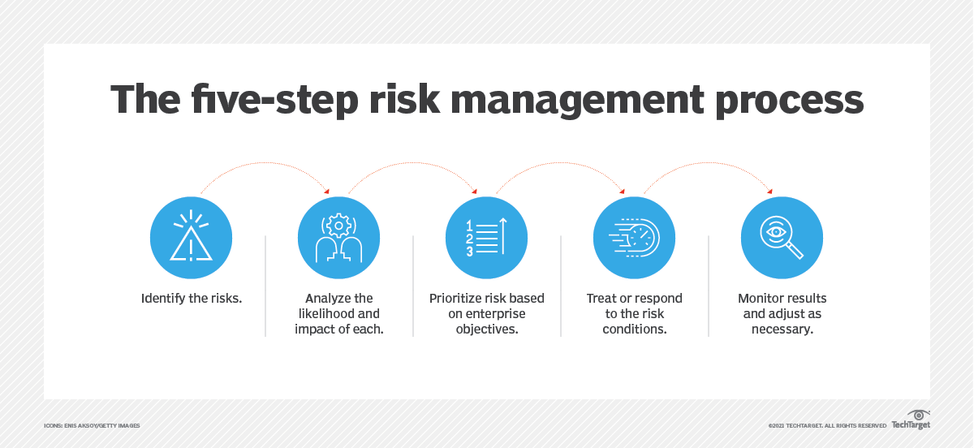
Risk Management Strategies

Slide 6
Data sources
In this project I did not use any dataset, it is the python APIs which scrape data as the code functions. These APIs are highly reliable and legally allowed to scrape data from websites.
Nasdaq stock symbols and names dataset from datahub.io (https://datahub.io/core/nasdaq-listings) to map symbols with names and scrape information using both symbols and names.
The twitter tweets data used for this project is fetched using Snscrape a python API to scrape twitter tweets with keyword search.
SimilarWeb API for website traffic information from similar webpage which contains website data of over 100 million websites. (https://www.similarweb.com)
yfinance API to scrape latest news articles and stock information.

Slide 7
Research question
This project aims to build a strong UI to take look at the how risk can be correlated with features such as news articles, social media responses(in this case twitter tweets) and webpage data collected web analytics which include traffic sources, referring sites, page views, paths taken and conversion rates.

Slide 8

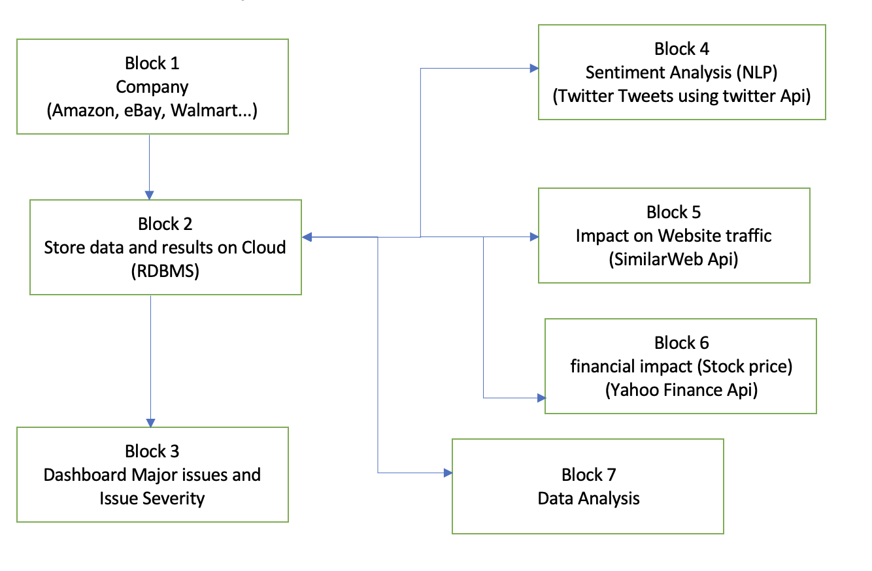
Flow Diagram
Block 1 Any company can be selected based on stock name
Block 2 Store data in cloud for easy access and prevent information loss
Block 3 Real time webpage-based dashboard providing sentiment, summery of news articles, other important webpage links.
Block 4 Sentiment analysis on news and twitter tweets
Block 5 Impact on website traffic
Block 6 Financial impact like stock price and trend.
Block 7 Data analysis based on all the data acquired for possible risk mitigation.

Slide 9
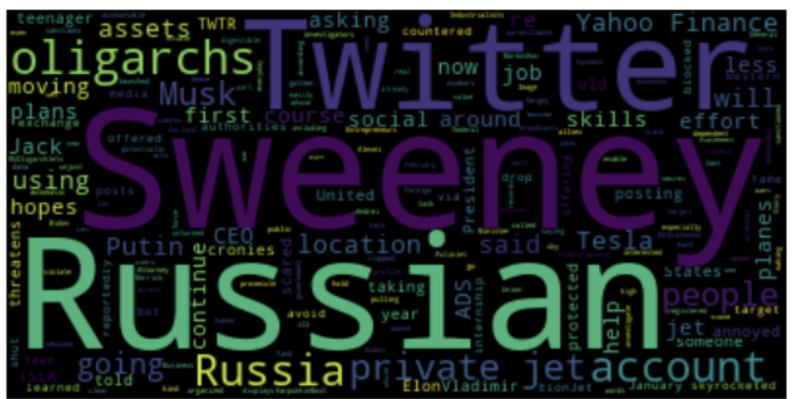
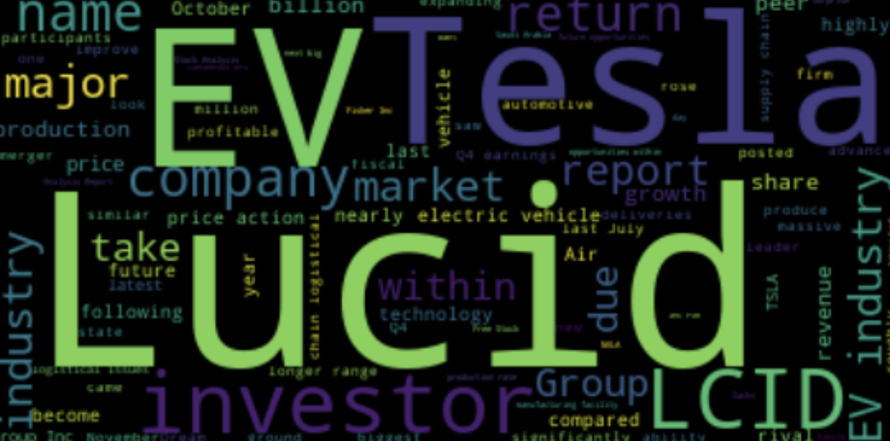
Initial EDA Results

Slide 10
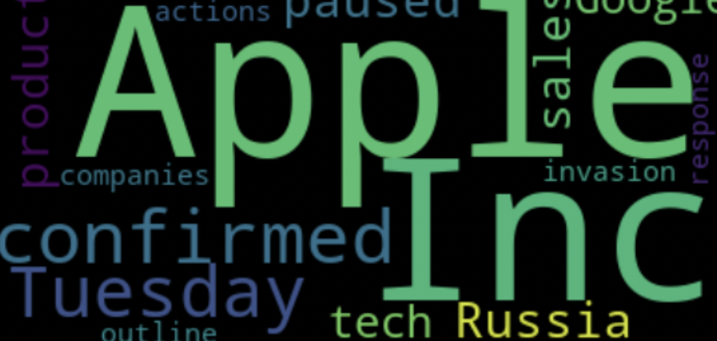
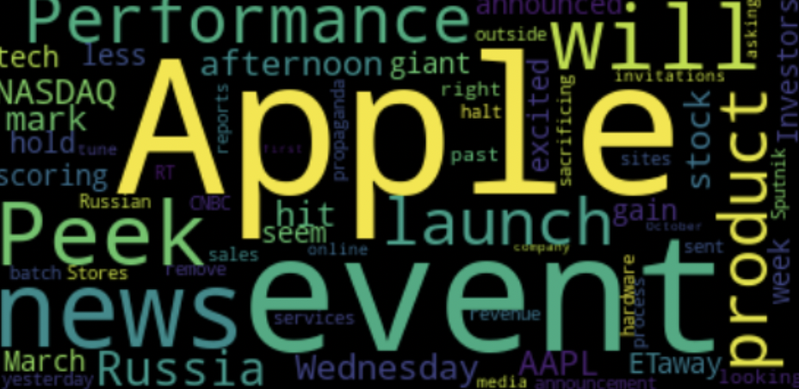

Slide 11
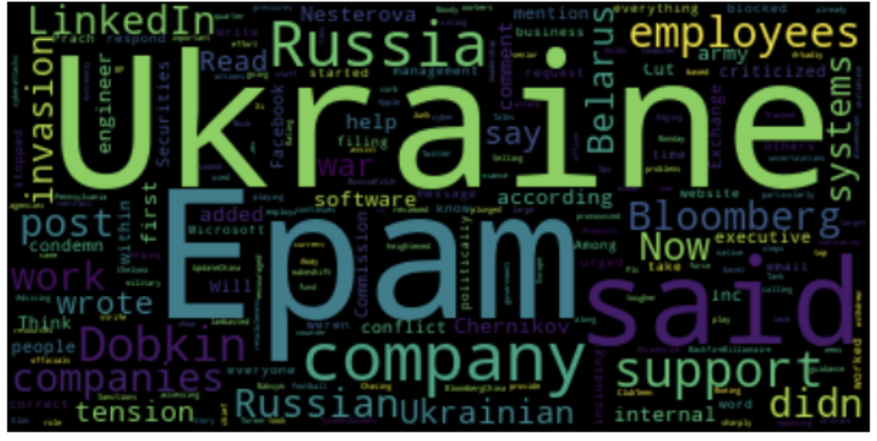
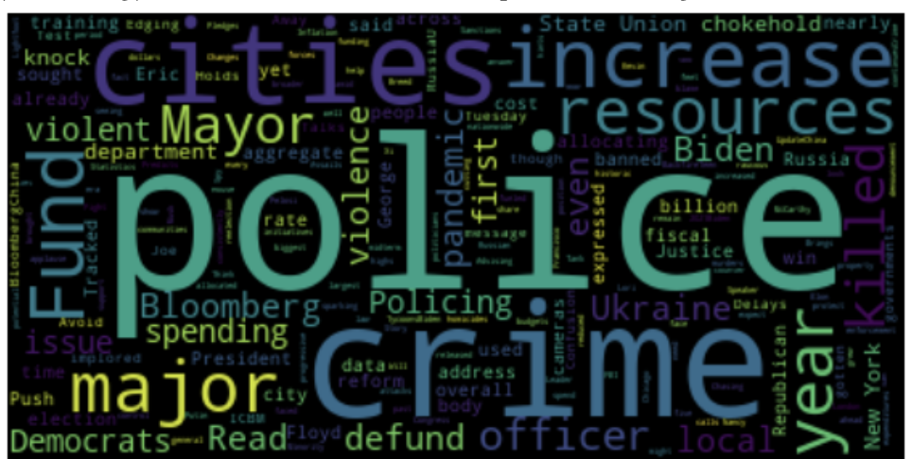
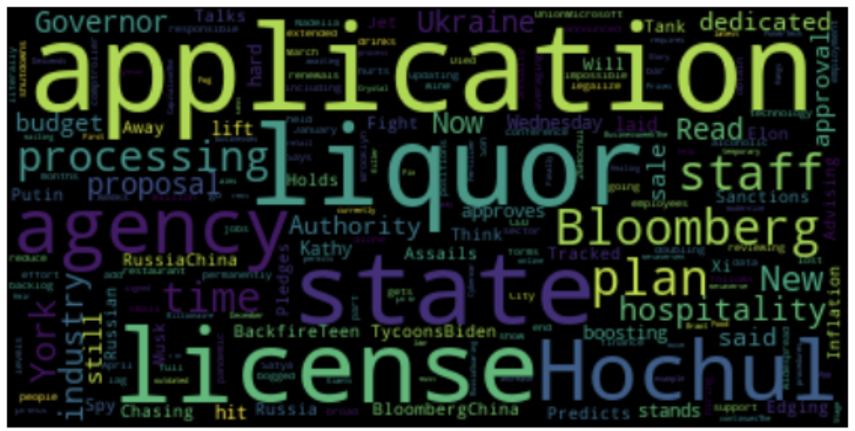
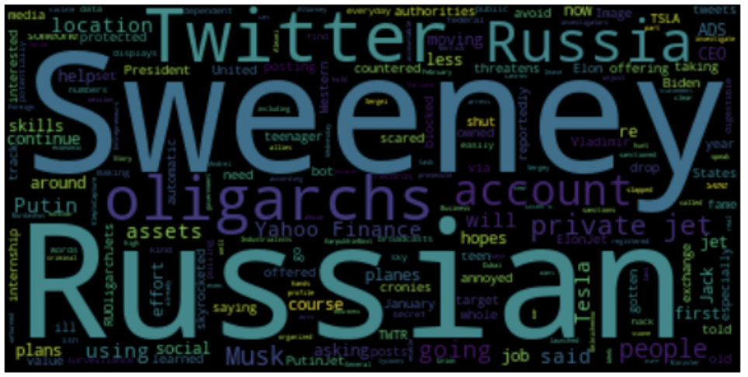

Slide 12
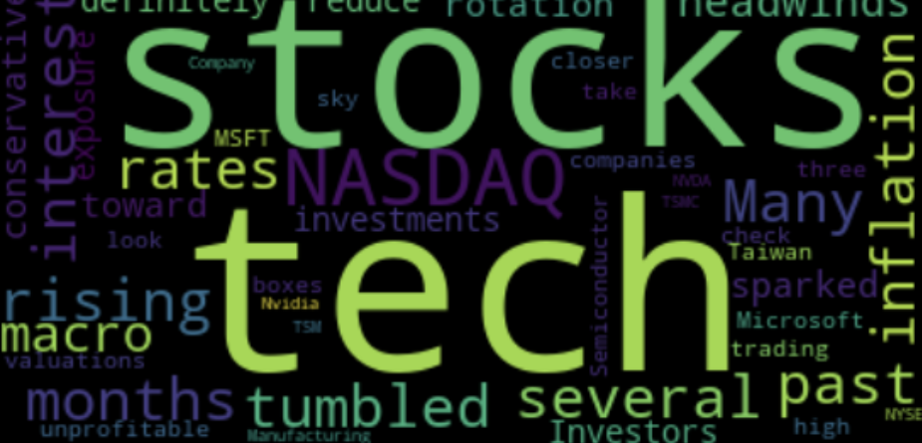
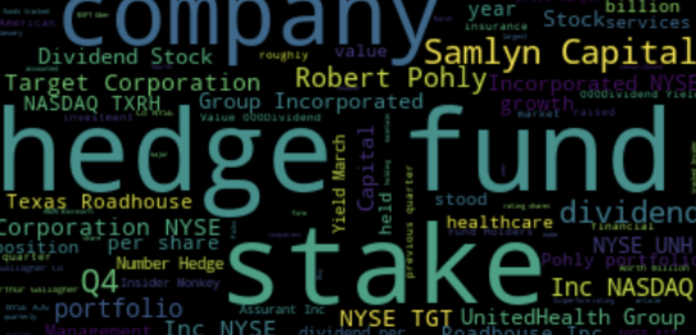
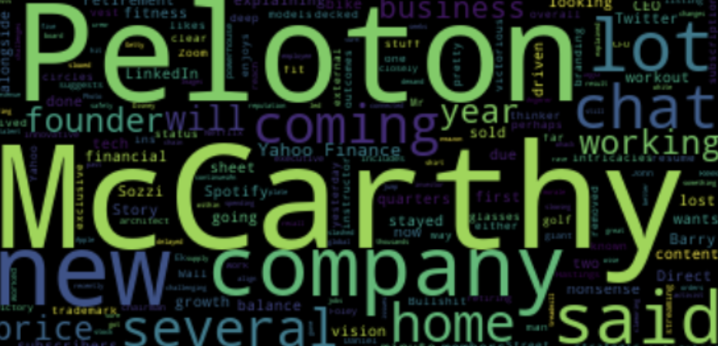

Slide 13
MACHINE LEARNING MODELS
Sentiment analysis is a text analysis technique that detects polarity (e.g., a positive or negative opinion) in a text, whether it's a whole document, a paragraph, a sentence, or a clause.
VADER ( Valence Aware Dictionary for Sentiment Reasoning) is a model used for text sentiment analysis that is sensitive to both polarity (positive/negative) and intensity (strength) of emotion. It is available in the NLTK package and can be applied directly to unlabeled text data.

Slide 14
Expected outcomes
This UI is expected to explore, analyze, and mitigate risk from various perspectives for an Organization.
It is a product to which a stock symbol can be given as input, and it returns an interactive UI showing the risks related to that company on a daily, weekly or monthly basis.
The system would also segregate these risks by considering all the factors into different priority levels.
These risks would be stored on daily basis for further analysis and find frequently occurring problems in the system.

Slide 15
Thank you

